Slide 1

Māori Quiz Documentation
Jireh

Slide 2
Maori Quiz
Link to GitHub Repository: https://github.com/jireh-t/Assessment
Links to Trello board / project management tools: https://trello.com/b/Oaxf98cy/assessment
Link to final version of your program:
Ensure you have made these links ‘public’ so that they are open to anyone, including the marker. The link to your program is the final outcome of this whole project – your finished program.

Slide 3
Describe relevant Implications:
Relevant implication | Describe the implication and give an example
Functionality | Functionality makes sure the program runs as its supposed to. It should work for all cases including boundary, expected, and unexpected.
Usability | Usability is how easy the program is to use. Instructions and error messages should be easily understood. Make sure the user does not feel frustrated.
Aesthetics | Aesthetics is how the program looks, and its appearance. An aesthetically pleasing program will contain well spaced instructions, prompts and decorations around key messages.
Notes:
Additional rows can be added by clicking in the last cell and then using the Tab key

Slide 4
Describe relevant Implications 2:
Relevant implication | Describe the implication and give an example
Social | Social implications are about the affect a computer program might have on users, the wider community, and society overall. For example, programs about gambling would be negative. Use clear instructions, and inoffensive feedback.
Future Proofing | Future proofing makes sure a program is flexible, adaptable, and easily modified. A programmer should be able to easily make changes, if it is well set out and commented. They should understand the purpose and reasoning behind the code. It is important to use constants rather than literals.
Notes:
Additional rows can be added by clicking in the last cell and then using the Tab key

Slide 5
Decomposition:
Paste screenshots of your initial Trello board / task decomposition on this slide. If you have a long list, you might need to break it up into several slides.
*Full decomposition will go here*
Notes:
Paste screenshots of your initial Trello board / task decomposition on this slide. If you have a long list, you might need to break it up into several slides.

Slide 6
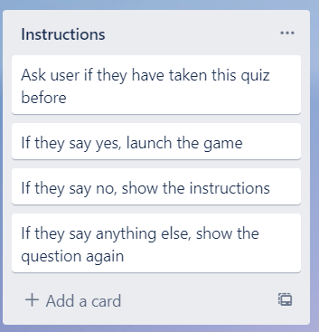
Component 1 (Instructions and Yes/No checker)
*Full decomposition will go here*

Slide 7
Yes/No Checker - Test Plan
Test Cases - input | Expected output
yes | Program continues
y | Program continues
No | Program continues
N | Program continues
Yes | Program continues
Maybe | Please answer "Yes" or "No"
Notes:
Additional rows can be added by clicking in the last cell and then using the Tab key

Slide 8
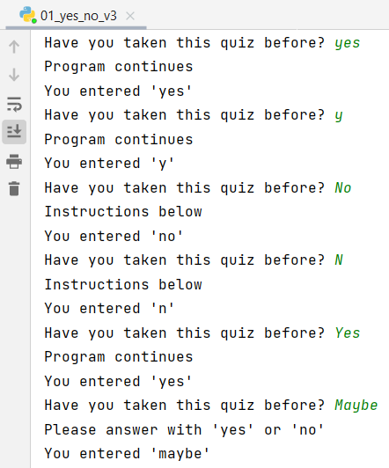
Yes/No Checker - Test Results
Test Cases - input | Expected output
yes | Program continues
y | Program continues
No | Program continues
N | Program continues
Yes | Program continues
Maybe | Please answer "Yes" or "No"
All tests worked as expected
Notes:
Additional rows can be added by clicking in the last cell and then using the Tab key

Slide 9
Yes/No Checker: Development
Trial 1 01_yes_no_v1 | The program works, but requires user to type lower caser. It won't accept "y" or "n"
Trial 2 01_yes_no_v2 | Added options for "y" or "n" Prints result of valid input, prevents invalid input Quite inefficient for testing
Trial 3 01_yes_no_v3 | Puts code into a loop to make testing easier
Trial 4 02_yes_no_function_v1 | The code from trial 3 made into a function, making it easy to reuse for other yes/no questions I might require in the program. I will use this function for my final project.
Notes:
Additional rows can be added by clicking in the last cell and then using the Tab key

Slide 10
Instructions - Test Plan
Test Cases - input | Expected output
Have you taken this quiz before? Maybe | <error> Please choose Y/N
Have you taken this quiz before? Yes | Quiz starts
Have you taken this quiz before? No | Show instructions, then start quiz
Notes:
Additional rows can be added by clicking in the last cell and then using the Tab key

Slide 11
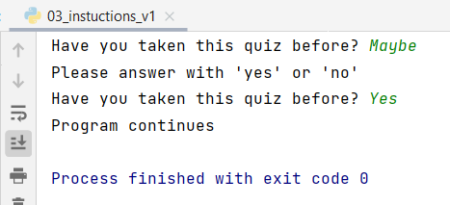
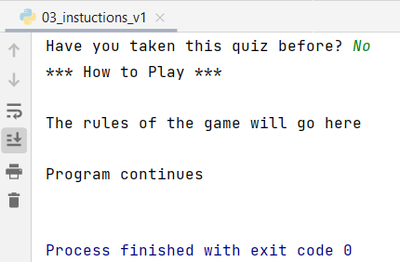
Instructions (with yes/no checker)
Test Cases - input | Expected output
Have you taken this quiz before? Maybe | <error> Please choose Y/N
Have you taken this quiz before? Yes | Game starts
Have you taken this quiz before? No | Show instructions, then start game
All tests worked as expected
Notes:
Additional rows can be added by clicking in the last cell and then using the Tab key

Slide 12
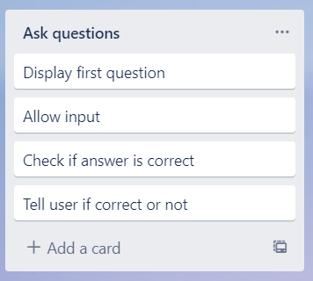
Component 2 – Ask questions/ Check answer

Slide 13
Questions - Test Plan
I will test each question and answer 4 times each
Test Cases - input | Expected output
tahi | Correct
Tahi | Correct
xxii ( incorrect answer) | Wrong The answer was …
11 (incorrect – integer) | Wrong The answer was …
Notes:
Additional rows can be added by clicking in the last cell and then using the Tab key

Slide 14
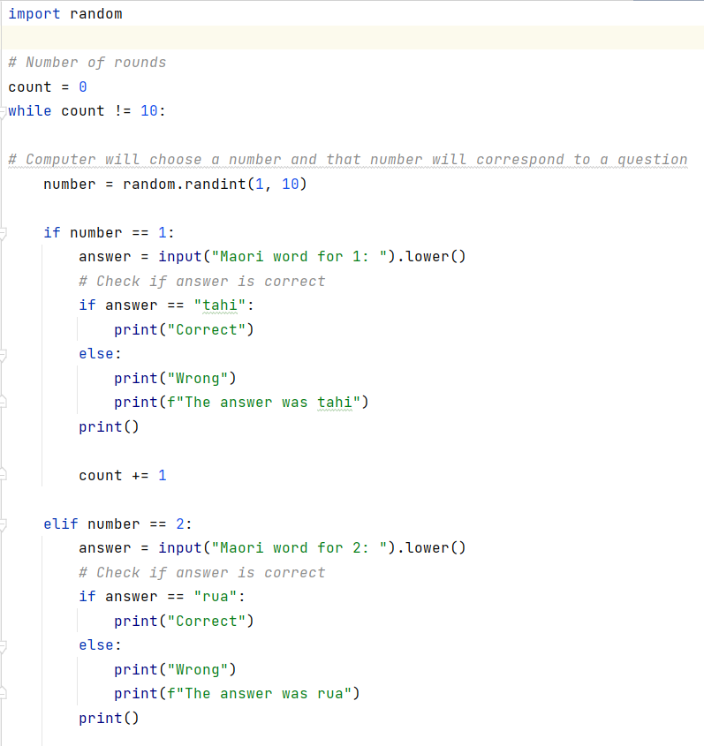
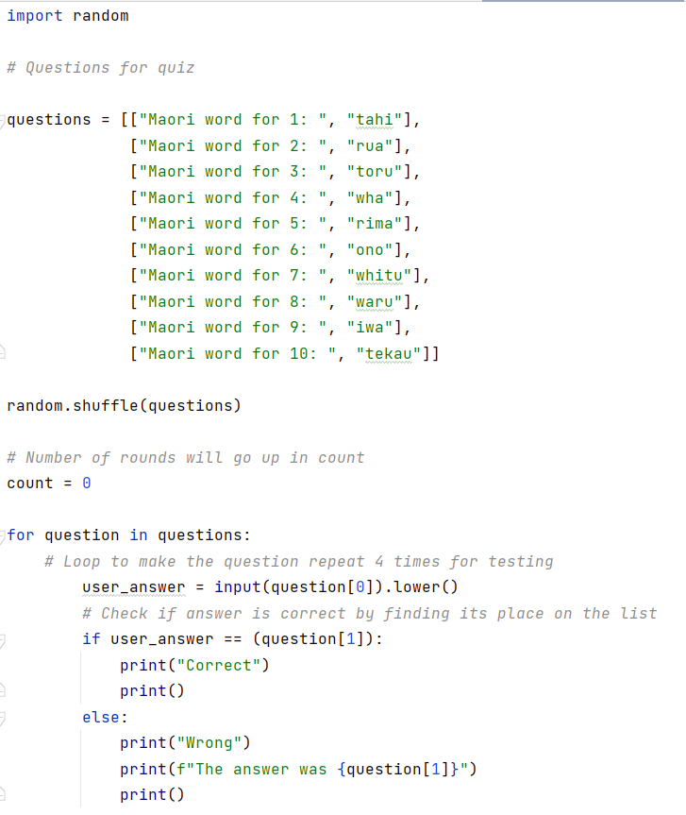

Trialling
TRIAL 1 gets questions from list
TRIAL 2 gets a random number that corresponds to a question

Slide 15
Selecting the best version for Questions/Answers
Trial 1 shuffles the list, and takes the questions from the list
Trial 2 randomly generates a number between 1 and 10, it then goes through a series of if statements according to which number
Trial 1 performed better than Trial 2 because it had no repeats of the same question
The first trial has much less code and is much more effective
Trial 2 is not effective because the questions may repeat and the code is large
Consequently, I have chosen to further develop Trial 1 for integration into my final program.

Slide 16
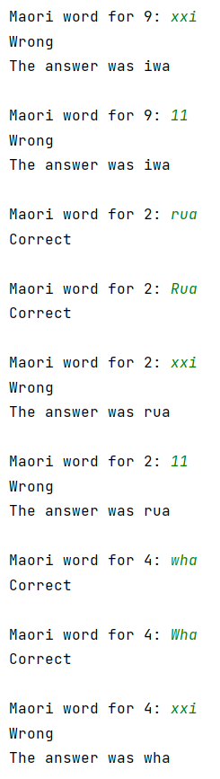
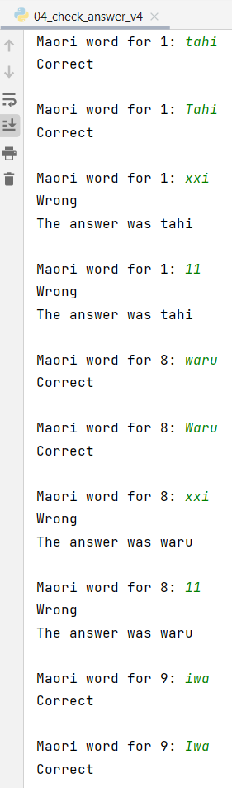
Questions/ Answers Testing
All tests passed.
Program works correctly for correct and wrong answers
Test Cases - input | Expected output
tahi (correct answer) | Correct
Tahi (correct answer with capital letter) | Correct
xxii ( incorrect answer) | Wrong The answer was …
11 (incorrect – integer) | Wrong The answer was …
Notes:
Additional rows can be added by clicking in the last cell and then using the Tab key

Slide 17
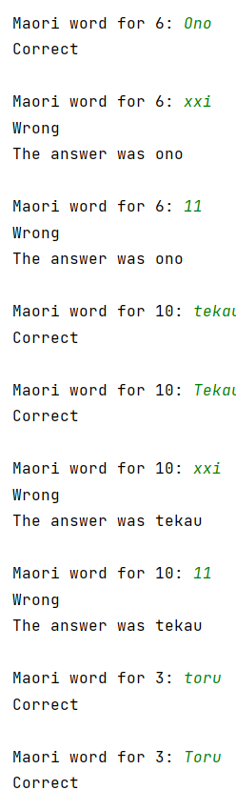
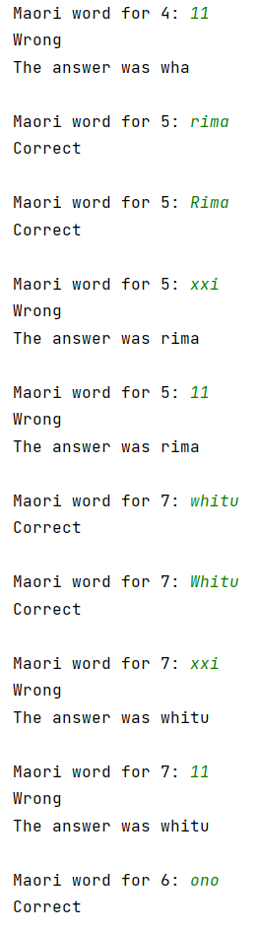
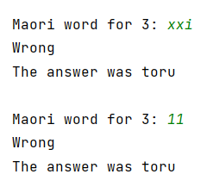
Questions/ Answers Testing 2
All tests passed.
Program works correctly for correct and wrong answers
Test Cases - input | Expected output
tahi (correct answer) | Correct
Tahi (correct answer with capital letter) | Correct
xxii ( incorrect answer) | Wrong The answer was …
11 (incorrect – integer) | Wrong The answer was …
Notes:
Additional rows can be added by clicking in the last cell and then using the Tab key

Slide 18
Questions & Answers: Development
Trial 1 04__check_answer_v1 | The program works, but only when you enter the answer with no capital letters. It goes through the questions in the same order which is not ideal for a quiz. There is no feedback given at the end.
Trial 2 04_check_answer_v2 | The program accepts correct answers with capital letters.
Trial 3 04_check_answer_v3 | The program randomly generates each question in a different order each time. The code is more concise in one list rather than two. The program also gives the correct answer if the answer was wrong, and there is clear spacing between each question.
Trial 4 04_check_answer_v4 | Added a loop to v3, to make it easier to test. I generated each question to print 4 times so I could carry out my tests.
I will use trial 3 in my real code, as it is the most effective and concise. Trial 4 was just for testing purposes.
Notes:
Additional rows can be added by clicking in the last cell and then using the Tab key

Slide 19
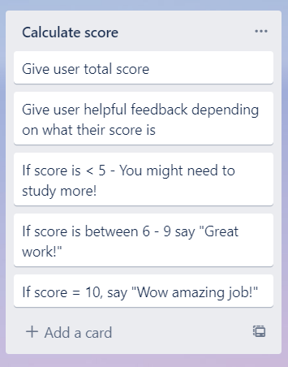
Component 3 – Calculate Score

Slide 20
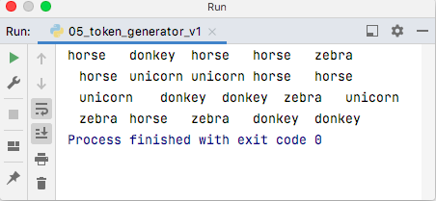
Randomly generated- Test Plan
Test Cases - input | Expected output
Run the program | Program should output 20 tokens with at least one of each: horse, donkey, zebra, and unicorn. The order of the tokens must be random.
Program generates random choices in a random order
Notes:
Additional rows can be added by clicking in the last cell and then using the Tab key

Slide 21
House has the advantage- Test Plan
Test Cases - input | Expected output
User starts with $100 Run the program | User should lose money (final balance should be less than $100)
Notes:
Additional rows can be added by clicking in the last cell and then using the Tab key

Slide 22
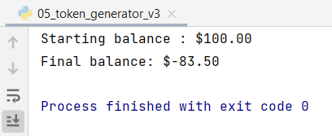
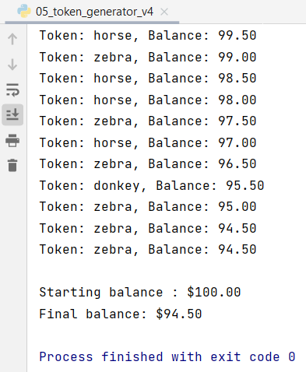

Generate random token - Testing
Testing on right (Trial 2) shows results for 100 rounds:
10% chance of unicorn
30% chance for each of donkey, zebra, and horse
Testing on right (Trial 3) shows results for only 10 rounds:
5% chance of a unicorn
30% chance of a donkey, 65% chance of each zebra or horse. The house advantage becomes clearer if we run the program more than 100 times

Slide 23
Generate Random Tokens: Trialing
Trial 1 05_token_generator_v2 | This program chooses from a list of horse, unicorn, zebra, and donkey. When run 100 times, it becomes clear that the house would lose money instead of making it.
Trial 2 05_token_generator_v3 | In this trial I changed the list so that there were 10% unicorns 30% of each of the others (1 unicorn and 3 each of the others). This did give the house an advantage.
Trial 3 05_token_generator_v4 | In my third trial, instead of choosing items from a list, I chose a random integer between 1 and 100. The schedule was set up so the user had a 5% chance of getting a unicorn, a 30% chance of getting a donkey, and a 65% chance of getting a horse or zebra. For this last 65% it awarded horse or zebra depending whether or not the number generated was even (horse) or odd (zebra)
Notes:
Additional rows can be added by clicking in the last cell and then using the Tab key

Slide 24
Game mechanics and looping: Test Plan
Test Cases - input | Expected output
User starts with $5 User continues playing until the money runs out | Game should go for 5 rounds. Each round should be correctly numbered After 5 rounds it should display 'Sorry you have run out of money'
User starts with $5 User plays 3 rounds and then exits | Game should go for 3 rounds When user enters 'X' the game should end Final balance should be $2
Notes:
Additional rows can be added by clicking in the last cell and then using the Tab key

Slide 25
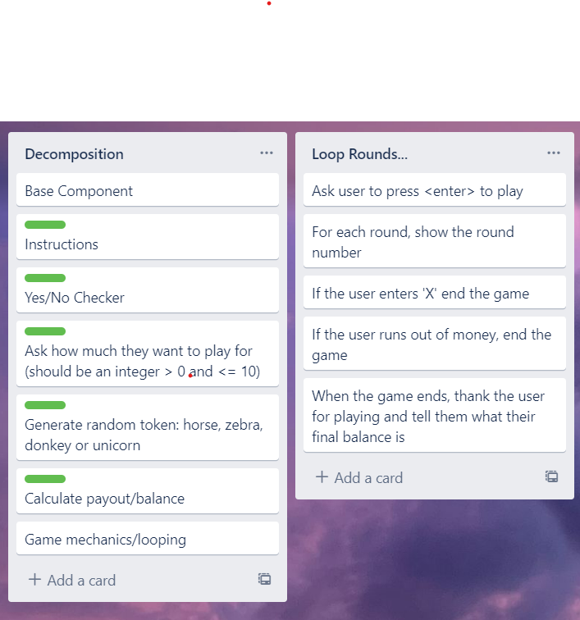
Component 4 (Game mechanics and looping)

Slide 26
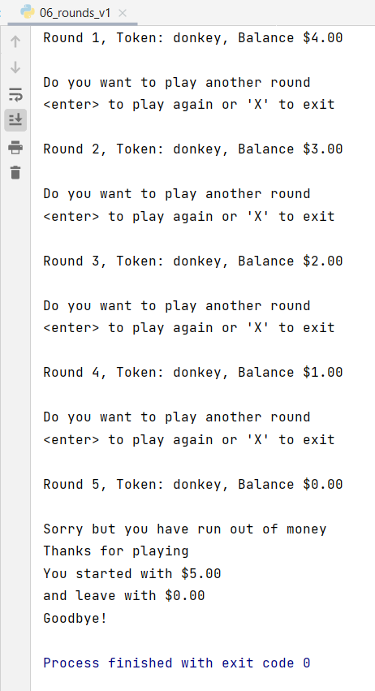
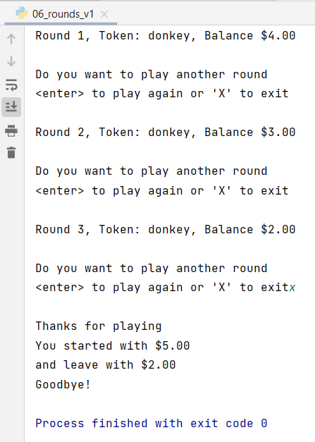
Game mechanics and looping - Testing
User can exit when prompted
Summary includes starting and finishing balances
Ran out of money, and ends the game as expected
Farewell message printed on exit

Slide 27
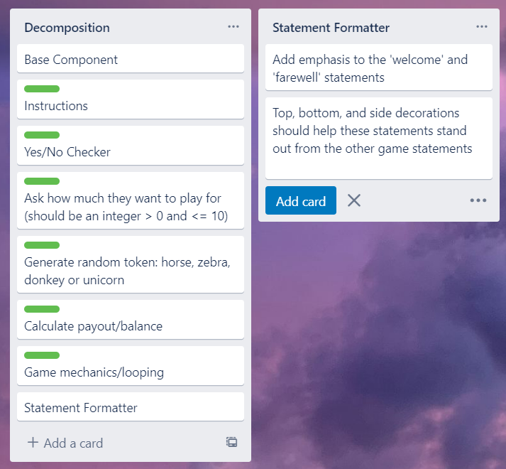
Component 5 (Statement Formatter)
I realised that we often need to make output stand out and creating a function to help to do this is a good idea. This component was added to the decomposition near the end of the development process.

Slide 28
Statement Formatter: Test Plan
Test Cases - input | Expected output
Statement 1: "Welcome to the Lucky Unicorn Game" | --------------------------------------------------------- --- Welcome to the Lucky Unicorn Game --- ---------------------------------------------------------
Statement 2: "Congratulations, you got a Unicorn!" | !!!!!!!!!!!!!!!!!!!!!!!!!!!!!!!!!!!!!!!!!!!!!!!!!!! !!! Congratulations, you got a Unicorn !!! !!!!!!!!!!!!!!!!!!!!!!!!!!!!!!!!!!!!!!!!!!!!!!!!!!!
Statement 3: "Goodbye" | *************** *** Goodbye *** ***************
Notes:
Additional rows can be added by clicking in the last cell and then using the Tab key

Slide 29
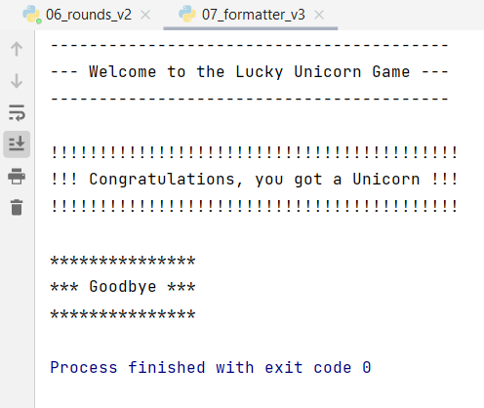
Statement Formatting - Testing
Statement formatter function worked as expected and produced the expected results.

Slide 30
Assembled Outcome: Test Plan
Test Cases - input | Expected output
Run program Played before = Maybe Played before = No | Welcome message displays Error – please answer yes or no Instructions display
Enter amount to play with xlii 0.5 0 11 1 | Error Error Error Error You are playing with $1. Press <enter> to start
Notes:
Additional rows can be added by clicking in the last cell and then using the Tab key

Slide 31
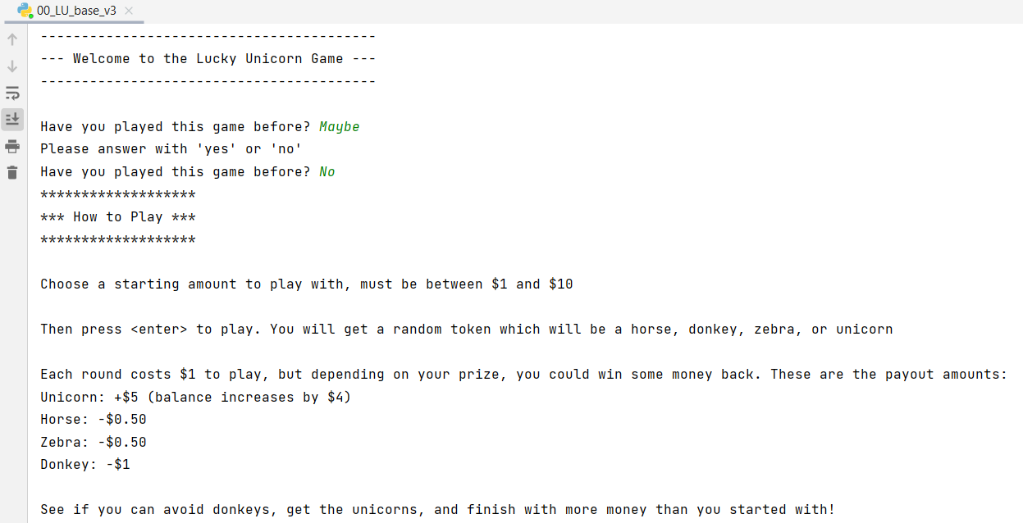
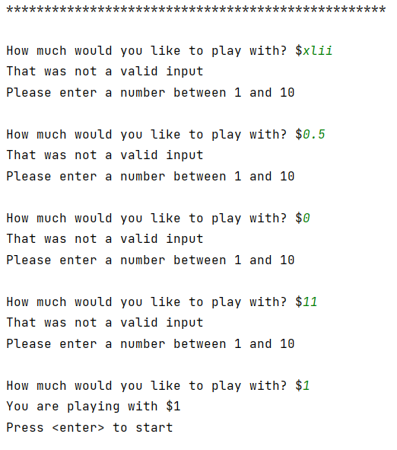
Assembled Outcome - Testing 1
Worked as expected – results produced match those in the plan on the preceding page.

Slide 32
Assembled Outcome 2: Test Plan
Test Cases - input | Expected output
Play with $1 until money runs out | For each round: Random token generated Balance and round number updated At end: Stats generated showing starting amount of $1 and final balance of $0.50 or $0.00
Run program Played before = yes Amount to play with = 10 | Welcome message displayed No instructions displayed
Notes:
Additional rows can be added by clicking in the last cell and then using the Tab key

Slide 33
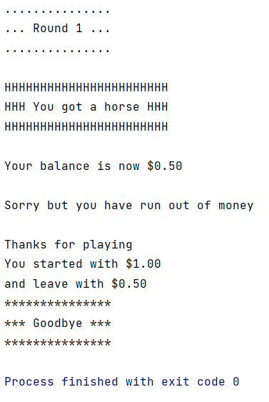
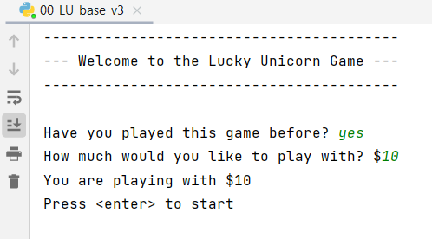
Assembled Outcome - Testing 2
Worked as expected – results produced match those in the plan on the preceding page.

Slide 34
Assembled Outcome 3: Test Plan
Test Cases - input | Expected output
Pay until balance is $3.00 /$2.50, then 'X' to quit | For each round: Random token generated Balance and round number updated (lose $1 for donkeys, lose $0.50 for horse or zebra, gain $4 for Unicorn) At end: Stats generated showing starting amount of $1 and final balance of $0.50 or $0.00
Notes:
Additional rows can be added by clicking in the last cell and then using the Tab key

Slide 35
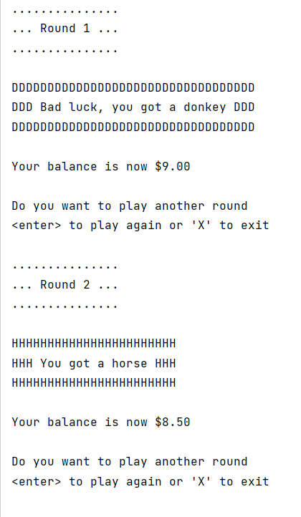
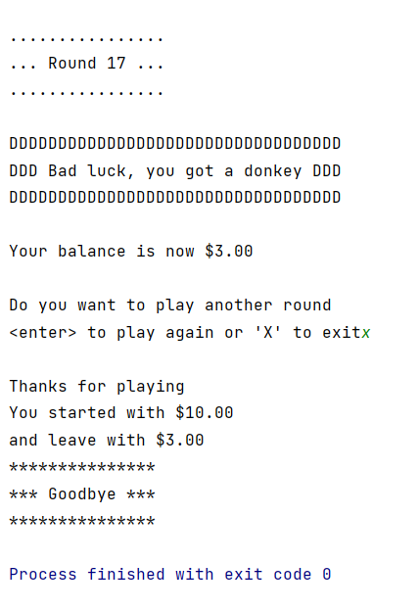
Assembled Outcome - Testing 3
Worked as expected – results produced match those in the plan on the preceding page.

Slide 36
Address relevant Implications:
Relevant implication | Explain how your final outcome addresses each implication
Functionality | I have thoroughly tested my outcome to ensure that the functionality implication has been addressed (i.e, it works for expected, unexpected, and boundary cases)
Usability | I have included optional instructions and clear error messages to make the outcome easy to use.
Aesthetics | I have used a statement generator to add decorations on important texts and have effectively spaced out the output to enhance the appearance. While aesthetics is not the main goal of this program, ensuring the outcome looks good can also help address the usability implication.
Social | My program has a $10 limit of how much the user can play with. This addresses the social implication of gambling, by making it difficult for the user to spend too much money.
Future Proofing | I avoided using literals and used functions to make my code is flexible easy to modify if needed. The code is clearly commented and well set out so another programmer could easily edit it in the future.

Slide 37
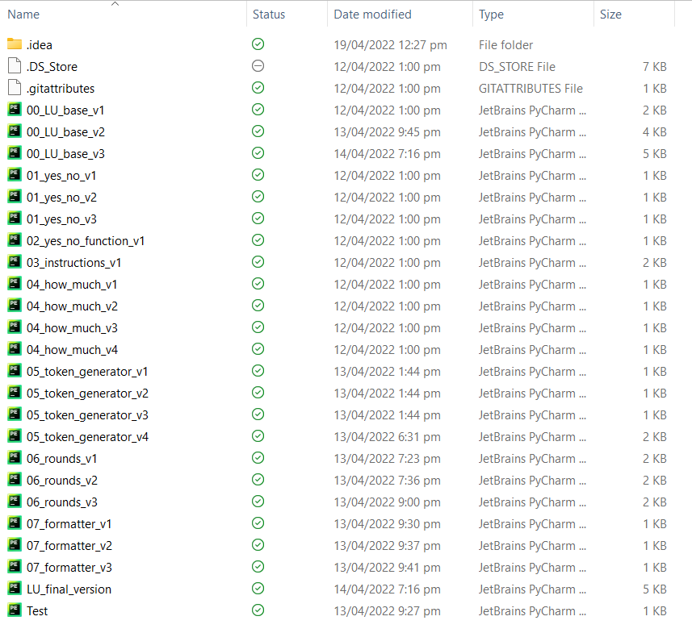
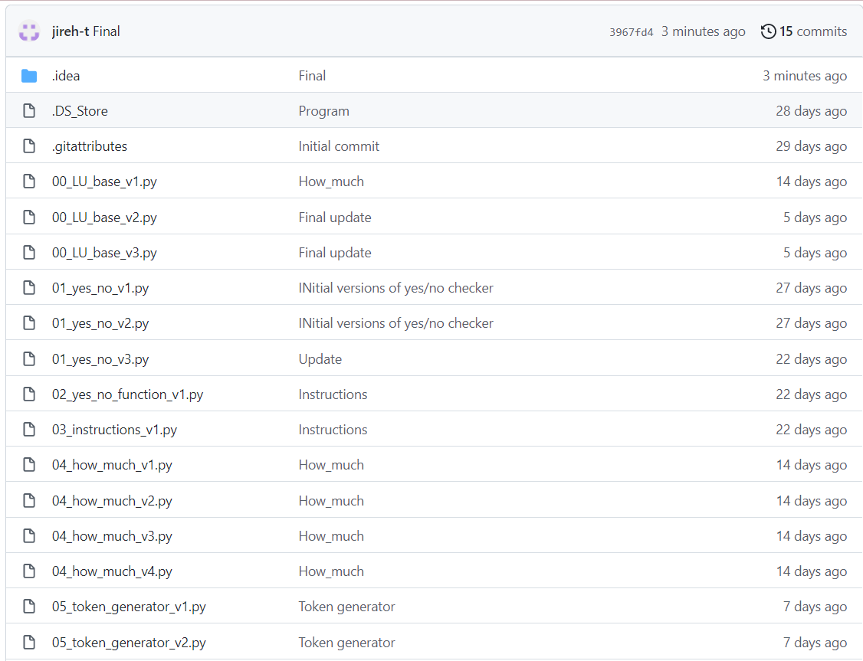
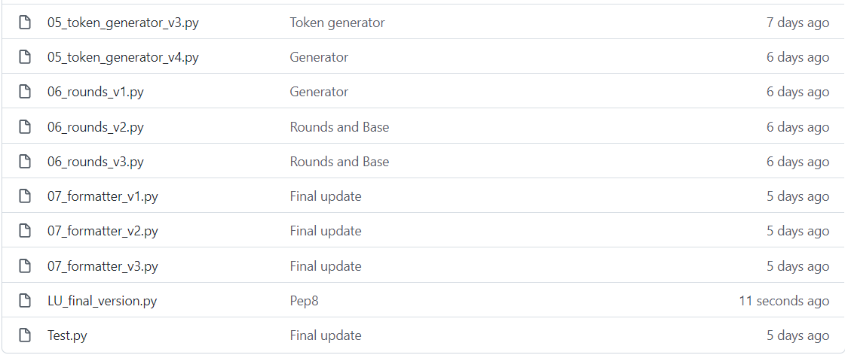
Version Control Evidence:
Project saved in GitHub repository
Local OneDrive directory
Notes:
Your version control evidence should go here. This could be in the form of screenshots (both of your GitHub repository as well as your local project folder) as evidence of your incremental development.

Slide 38
Final Discussion:
While developing this program, I planned, tested and trialled each individual component and then tested it together as a whole game
By decomposing the problem, I could efficiently plan my program and focus on creating and testing small chunks of code. I thoroughly tested the code during and after construction.
By testing, I was able to see the flaws in my program, and fix them before adding to the full program
Having volunteers use my program enabled me to improve its functionality and receive ideas about how I could make it better. This raised the reliability and quality of the final outcome.
User feedback enabled me to see the program from a non-programmer's point of view. The information from the planning, testing, and trialling and user feedback, enabled me to produce a high-quality outcome.
I made sure my code met all Pep8 standards by checking it through here pep8online
(see the next slide)
Notes:
Discuss how the information from planning, testing and trialling of components assisted in the development of a high-quality outcome.

Slide 39
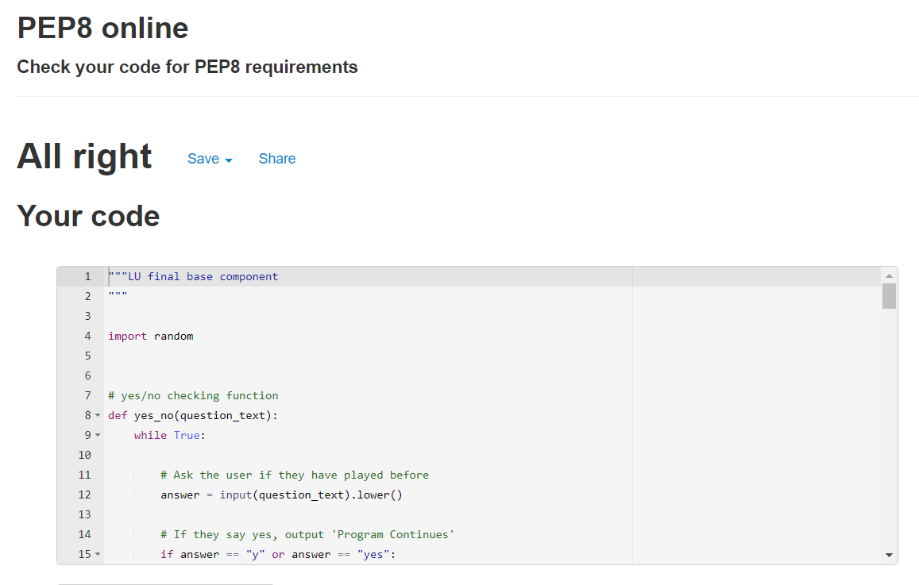
Evidence of meeting PEP8 requirements

